Slide 1
Introduction to React.js
Mar 16th 2019 NUS Hacker School
Shi Tianyuan

Slide 2


What you need before getting started
Node.js LTS or newer version
(Our Development Environment)
Visual Studio Code
(A fantastic text editor)

Slide 3
What is React.js
“
React is a declarative, efficient, and flexible JavaScript library for building user interfaces. It lets you compose complex UIs from small and isolated pieces of code called “components”.
”
It does the same thing as your normal HTML + CSS + JavaScript, but in a different and more efficient manner.

Slide 4
What is React.js
Component-based library for building frontend UI
JavaScript (JS)-based
Each page is powered by many components
Components can contain other components

Slide 5
Web Applications Written in React
Outlook Web Mail
Instagram
Facebook
WhatsApp Web

Slide 6
Why do we use React?
Same reason why there's a need for frameworks in backend development
For large-scale application, frontend development is non-trival
Need to have a more systematic approach of doing development

Slide 7
Why do we use React?
TRADITIONAL JAVASCRIPT
State changes -> Define and make UI changes yourself (manual)
Listen for changes
Add a new todo item
Append new item to item list
Keep track of which new item was added
Use jQuery to update multiple parts of the UI
You need to keep track of state

Slide 8
Why do we use React?
REACT.JS
State changes -> UI re-renders based on new state (auto)

Slide 9
Benefits of React
Helps to manage the DOM automatically
Fast - Virtual DOM
Large community
Makes it easy to create Single Page Application

Slide 10
Overview
Recap JavaScript (ES6) Knowledge
React Development Basics
JSX
Component
State
Component Lifecycle
Props
Create a TODO App on your own! (starter code given here)
Finished project effect

Slide 11
Recap
ES6 variable keyword, arrow function and class

Slide 12
Recap ES6 – let
The let statement declares a block scope local variable, optionally initializing it to a value.
let x = 1;
if (x === 1) {
let x = 2;
console.log(x);
// expected output: 2
}
console.log(x);
// expected output: 1

Slide 13
Recap ES6 – const
Constants are block-scoped, much like variables defined using the let statement. The value of a constant cannot change through reassignment, and it can't be redeclared.
const number = 42;
try {
number = 99;
} catch(err) {
console.log(err);
// expected output: TypeError: invalid assignment to const 'number'
// Note - error messages will vary depending on browser
}
console.log(number);
// expected output: 42

Slide 14
Recap ES6 – arrow function
Arrow functions are a different way of creating functions in JavaScript. Besides a shorter syntax, they offer advantages when it comes to keeping the scope of the this keyword
var elements = [
'Hydrogen',
'Helium',
'Lithium',
'Beryllium'
];
elements.map(function(element) {
return element.length;
}); // this statement returns the array: [8, 6, 7, 9]
// The regular function above can be written as the arrow function below
elements.map((element) => {
return element.length;
}); // [8, 6, 7, 9]
// When there is only one parameter, we can remove the surrounding parenthesies:
elements.map(element => {
return element.length;
}); // [8, 6, 7, 9]

Slide 15
Recap ES6 – Class
JavaScript Class is similar to Java Class, take note of the pattern, we are going to use this later
class Rectangle {
constructor(height, width) {
this.height = height;
this.width = width;
}
// Getter
get area() {
return this.calcArea();
}
// Method
calcArea() {
return this.height * this.width;
}
}

Slide 16
Start with React

Slide 17
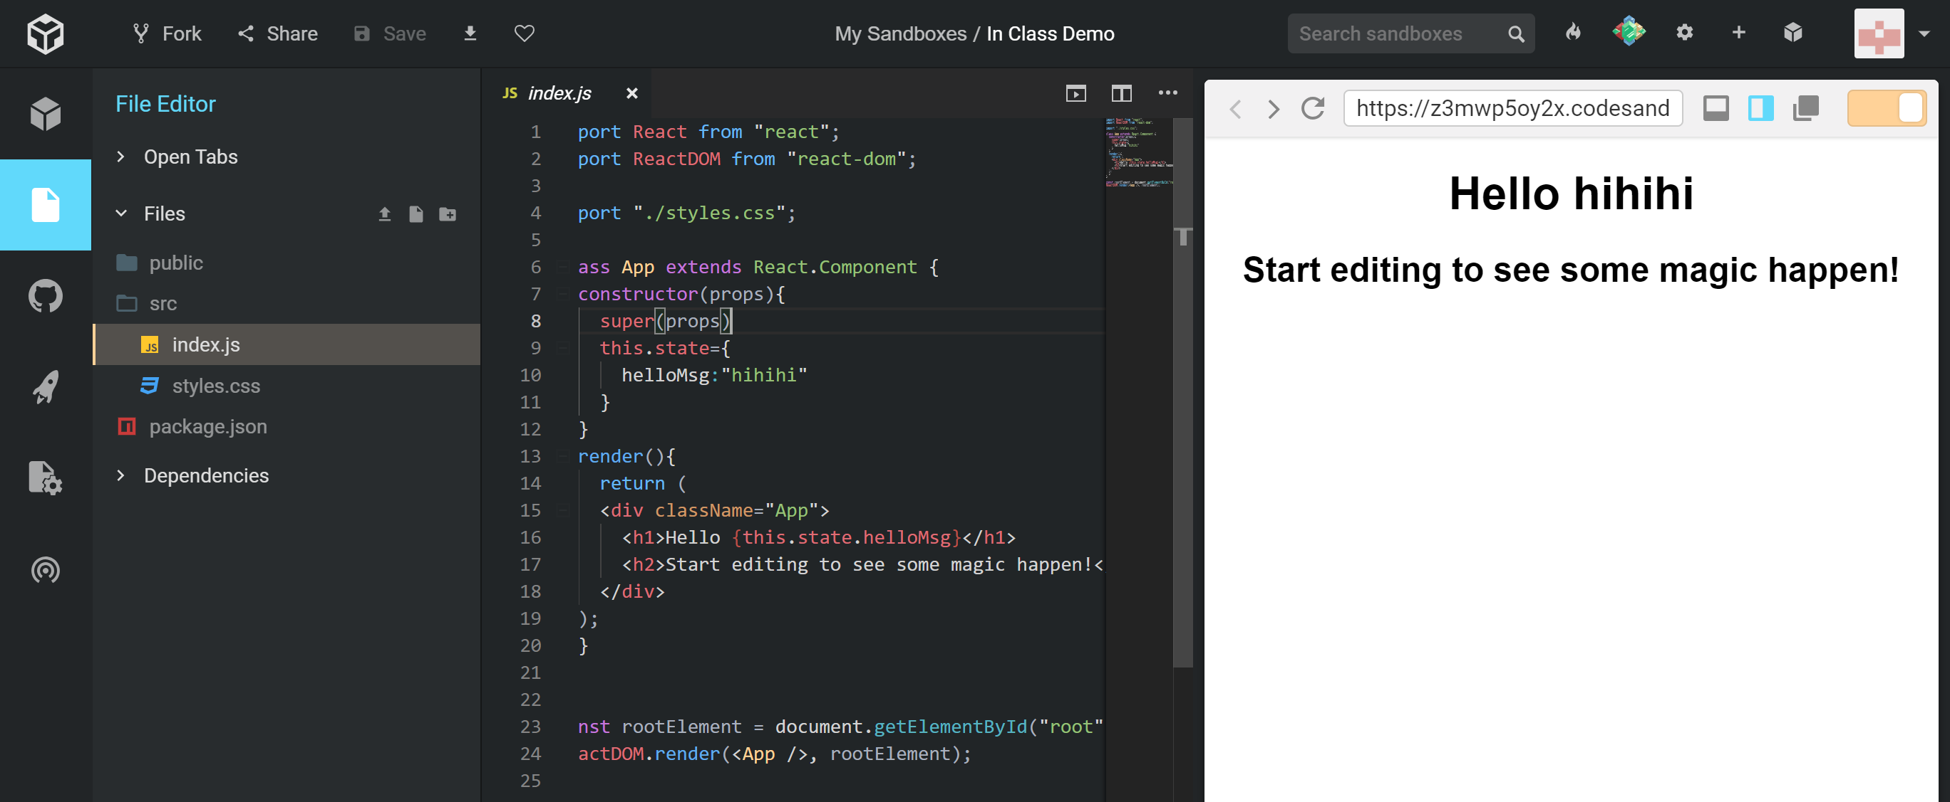
Online Editor
Google codesandbox.io
Login with your preferred account
Create a React Sandbox
We are good to go now!

Slide 18
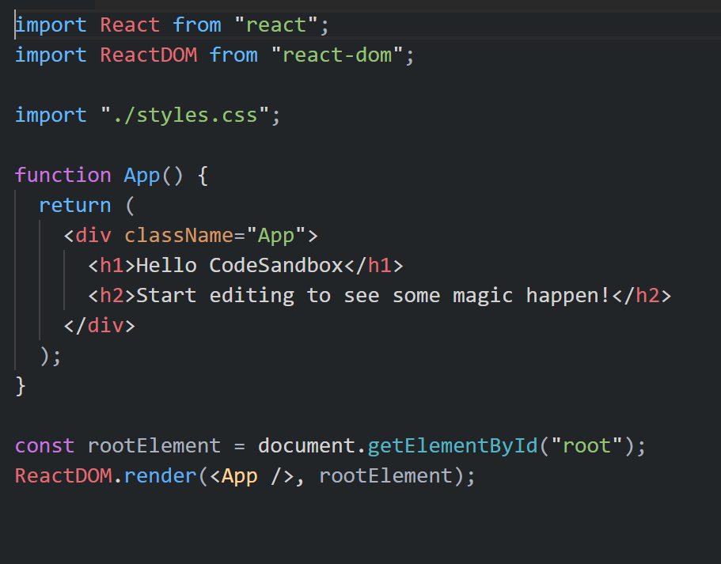
Explore the starter code
Stateless Function Component
JSX (it looks like HTML but it is not)
How your components are rendered to your web browser

Slide 19
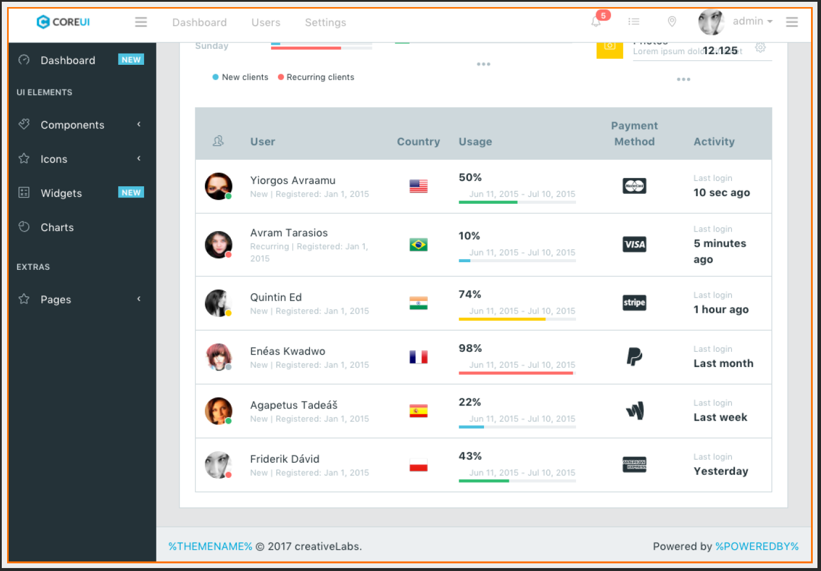
Components I
Entire page consists of a component

Slide 20
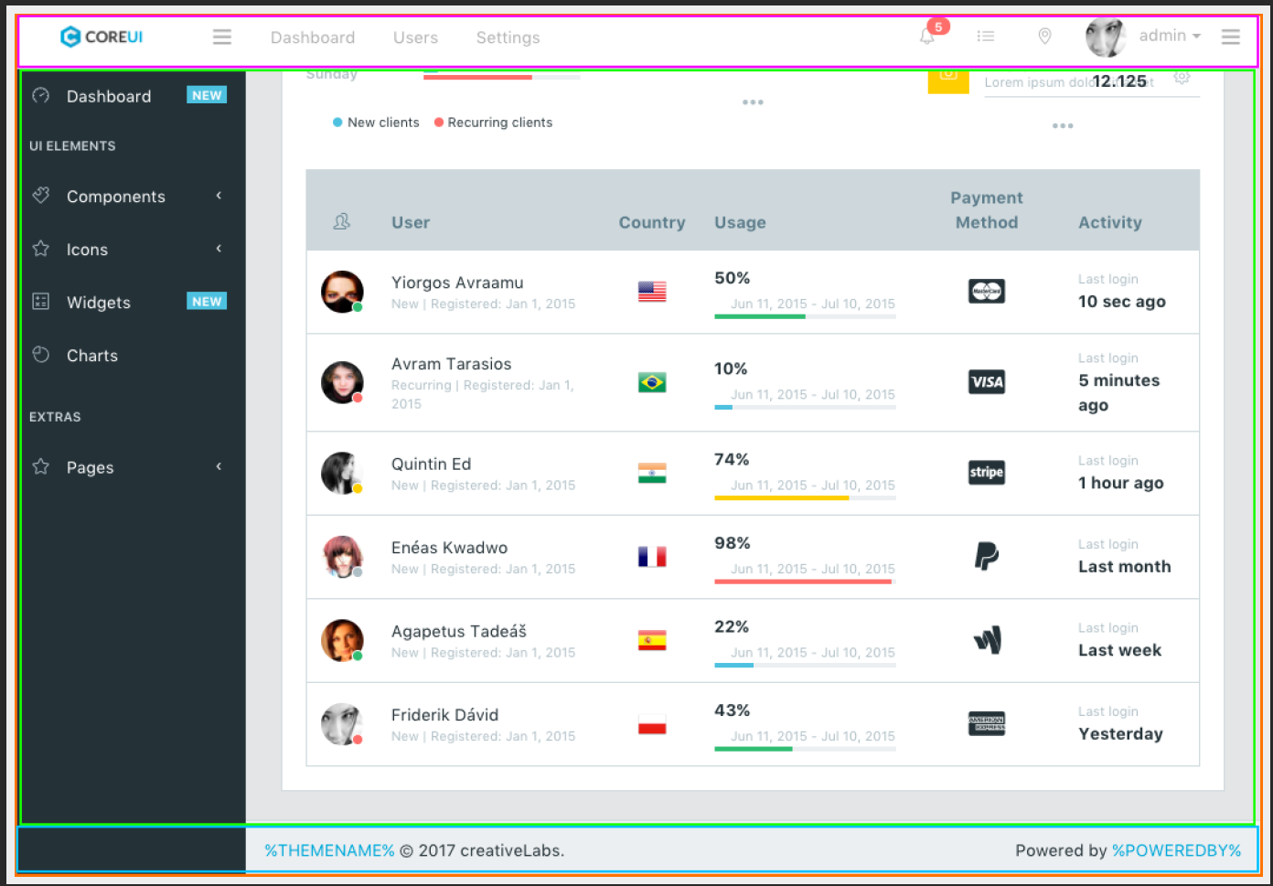
Components II
This component contains other components: Header, Body, Footer

Slide 21
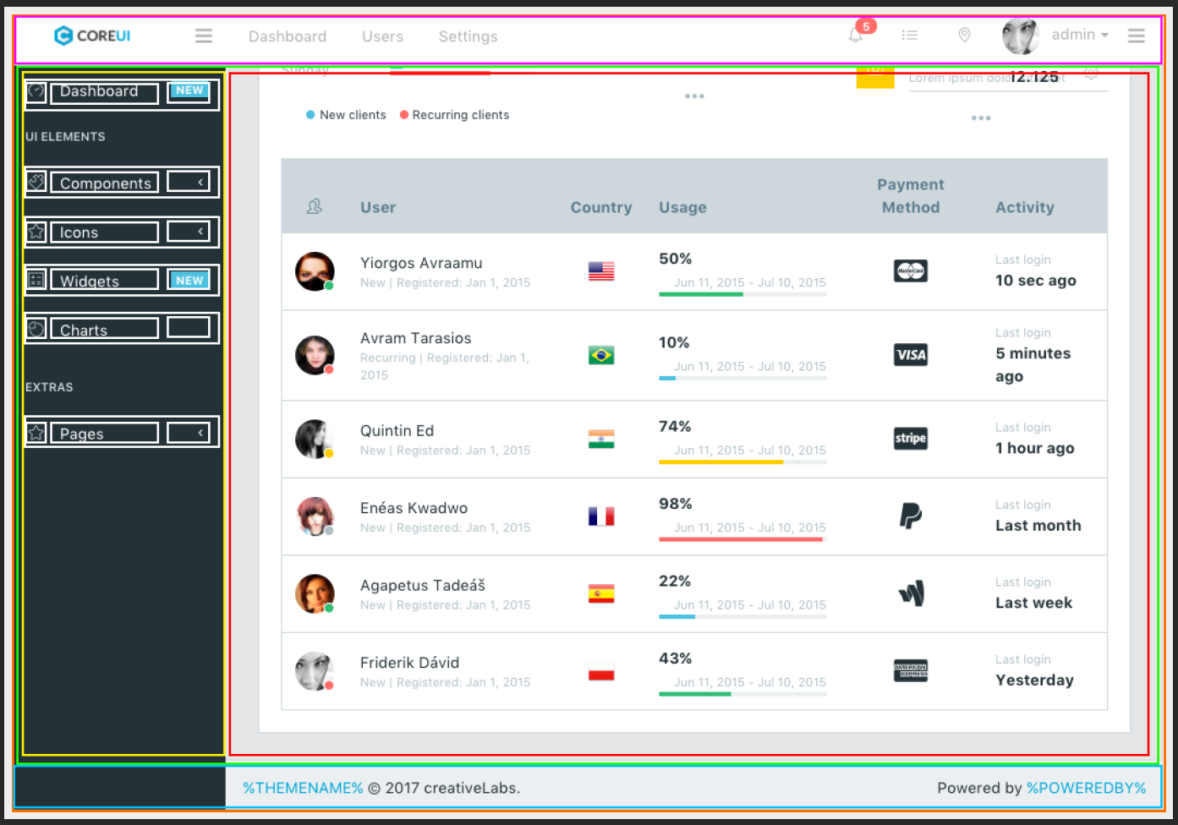
Components III
The SideBar can contain a MenuBar, which consists of MenuItems, etc

Slide 22
React Components
React component extends the HTML vocabulary
Coding style involve writing HTML inside the JS codes
3 ways to define components
React.createClass()
ES6 Component
Stateless function
We will talk about state later
Syntax Example on the next page

Slide 23
React.createClass
const MenuComponent = React.createClass({
render() {
return (
<div>
<a href="http://www.google.com">Google</a><br />
<a href="http://www.yahoo.com">Yahoo</a><br />
<a href="http://www.facebook.com">Facebook</a><br />
</div>
);
}
});

Slide 24
ES6 Class Component
class MenuComponent extends React.Component {
render() {
return (
<div>
<a href="http://www.google.com">Google</a><br />
<a href="http://www.yahoo.com">Yahoo</a><br />
<a href="http://www.facebook.com">Facebook</a><br />
</div>
);
}
}

Slide 25
Stateless Functions
const MenuComponent = () => {
return (
<div>
<a href="http://www.google.com">Google</a><br />
<a href="http://www.yahoo.com">Yahoo</a><br />
<a href="http://www.facebook.com">Facebook</a><br />
</div>
);
}

Slide 26
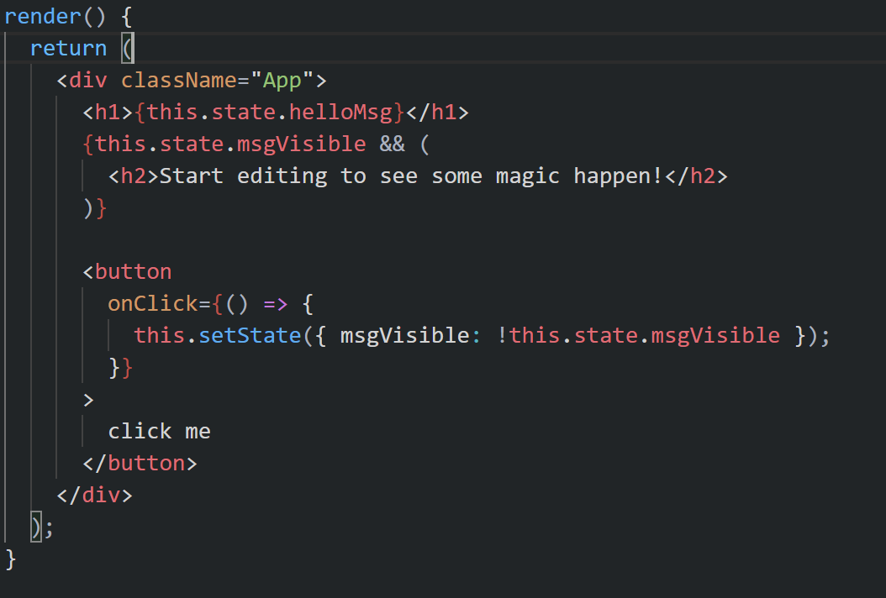
JSX
Insert Dynamic Value
Conditional Rendering
Example

Slide 27
Props
One of the main benefits of components is reusability
Values can be supplied to components as props
Hello John Doe
props: {“first":"John", "last":"Doe"}
<GreetingComponent first="John" last="Doe"/>
class GreetingComponent extends React.Component{
render(){
return ( <p>Hello {this.props.first} {this.props.last}</p> );
}
}

Slide 28
Props Passing Values
Use { } in order to pass values as props when they are not string type
e.g. numeric values and objects have to be enclosed with { }
<MyComponent
field1="some_string"
field2={10}
field3={["item1", "item2"]}
field4={{name:"John", age:10}}/>

Slide 29
State
Props are often used for initial rendering but often the UI will change over time (e.g. due to events)
Props is fixed (and supplied by the caller) while state will change over time
See Example
Notice how the tick function is triggered (component life cycle)

Slide 30
Summary
This workshop has covered the basics of Web Development with React.js
JSX and Components Syntax
State and Props
What has been taught today is just the basic syntax and definitions, but should be enough to get you started.

Slide 31
Next Steps
React-Router for front-end routing
Redux for state management
React Native for Mobile App Development

Slide 32
You can start to build your first TODO App now!
starter code given here
Finished project effect
You may refer to the official tutorial in case you are not clear about anything.

Slide 33
References
https://javascript101.netlify.com
https://developer.mozilla.org/en-US/docs/Web/JavaScript/Reference
https://www.youtube.com/watch?v=3qk6yQWKVoQ
Facebook React Tutorial
Dr. Lek Hsiang Hui’s IS3106 Notes (special thanks prof!)

